Slide 1
March 12, 2020

Slide 2
Street Closure Updates

Slide 7
Street Closure Coordination
8 weeks out
Coordination with City/County partnerships
Subcommittee presentation - public
7 weeks out
Block walking surrounding businesses
Called/emailed surrounding businesses
5 weeks out
Post on NextDoor App
Eblast communication – weekly newsletter
Available on website
Sent information to community partners for sharing
3 weeks out
Mailed/emailed flyers to surrounding businesses
Social media sharing
2 weeks out
Media advisory
Reminder email to all businesses
Reminder post on NextDoor app

Slide 8
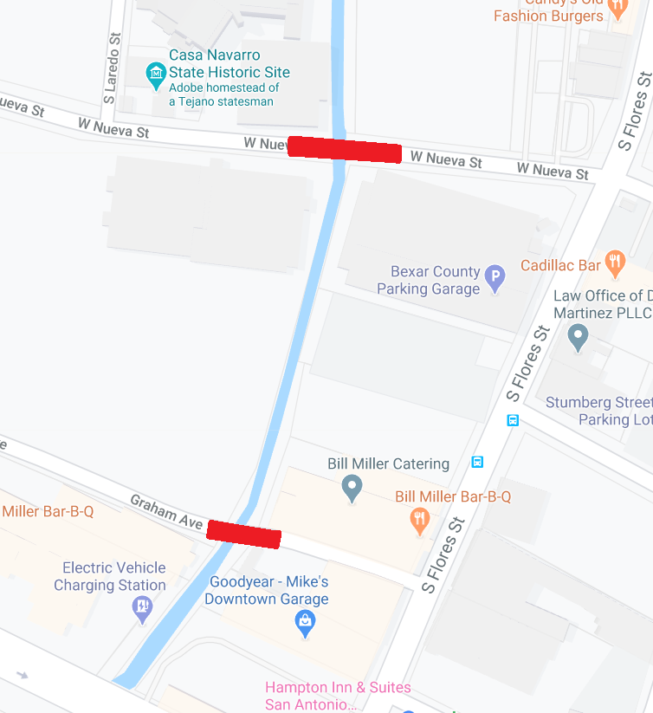
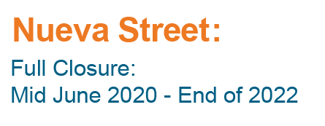
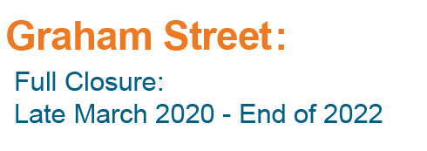

Slide 9
QUESTIONS

