Slide 1
March 12, 2020

Slide 2
Updates
Phase 1.2
Construction activities
Archaeological exploration
Phases 1.3 and 2
Design Activities
Partner Coordination

Slide 3
Phase 1.2 Construction

Slide 4
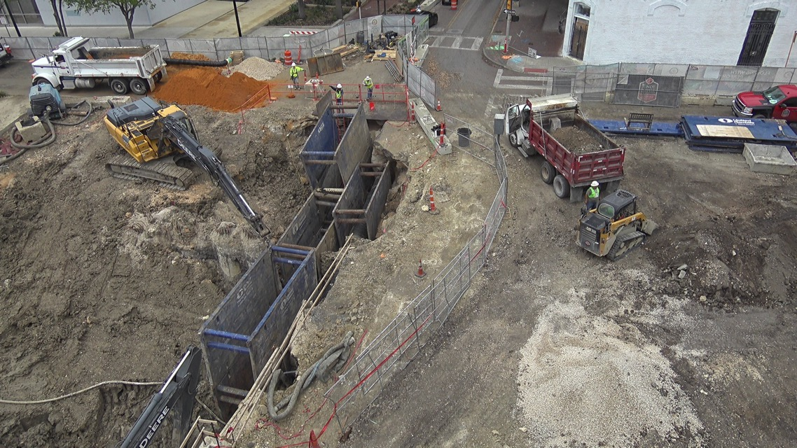
Phase 1.2 Construction
Houston to Commerce
Utility Installation
Plaza paving
Commerce to Dolorosa
Dolorosa street bridge
Calder Alley Paving
Spanish Governor’s Palace
Dolorosa to Nueva
Site work for paseo/plaza paving

Slide 5
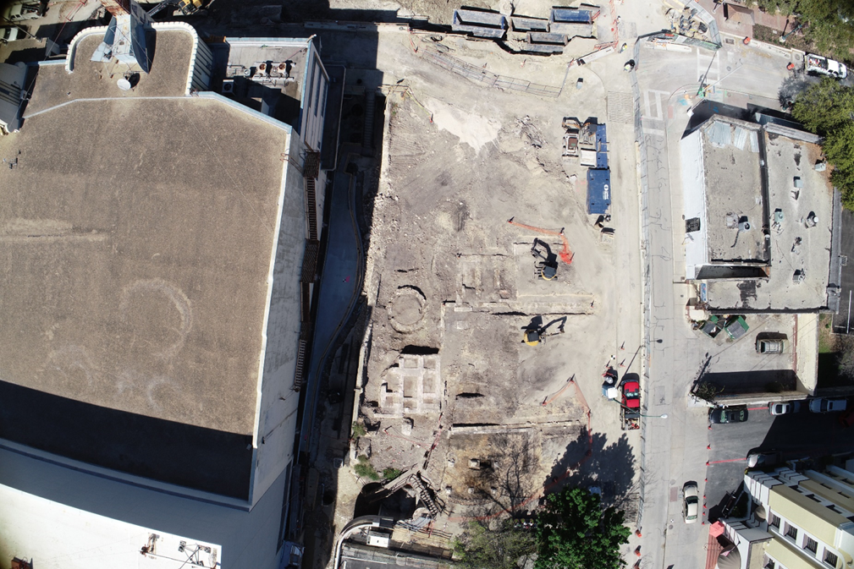
Archaeological Exploration
Several foundations uncovered
Alamo Ice House
Supporting cistern
Original Menger Soapworks location
Original AME Church location

Slide 8
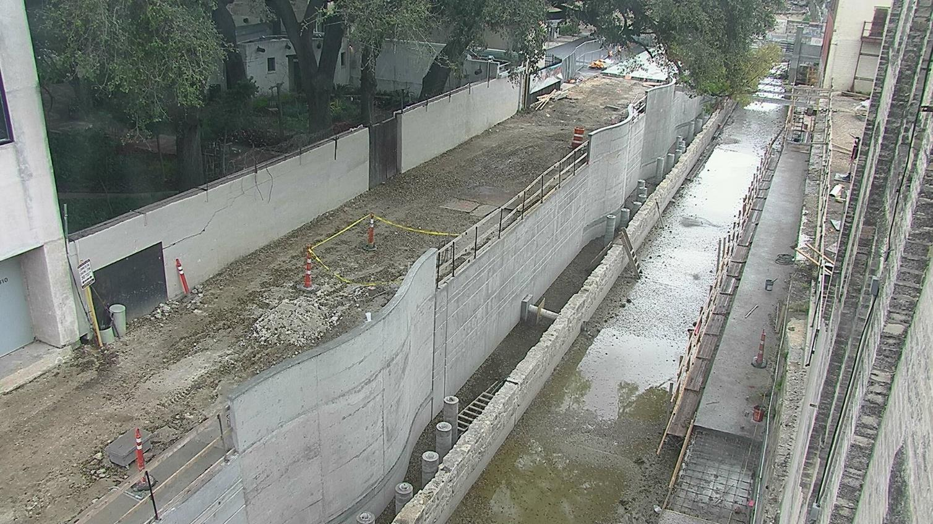

Slide 9
Phase 1.3 and Phase 2 Design

Slide 10
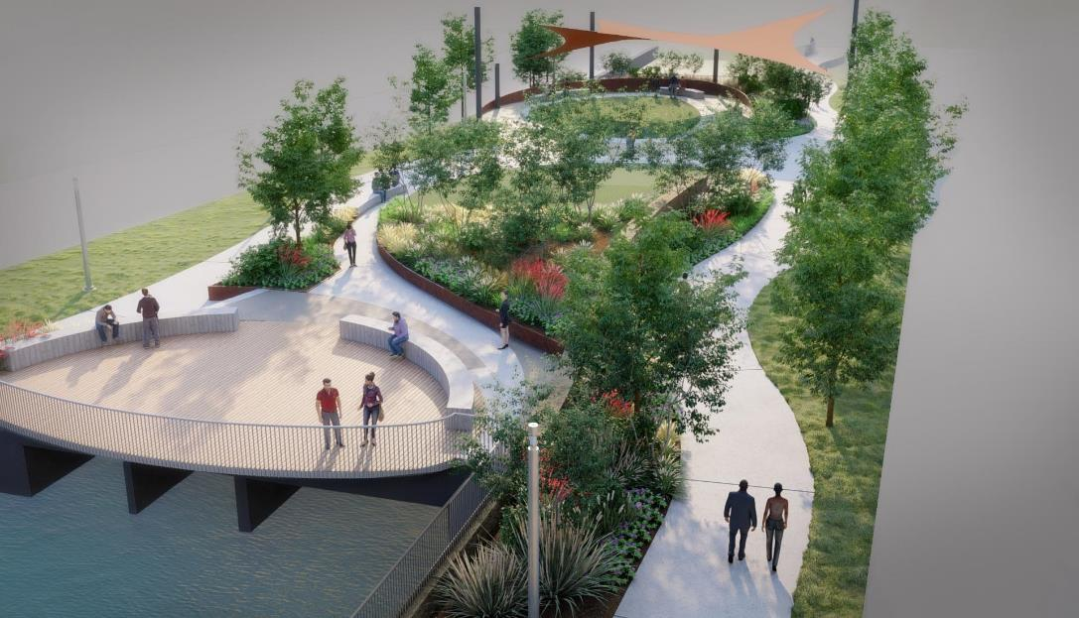
Phase 1.3 and Phase 2 Design
Design ongoing
Early Work Packages approved
March 2020: Construction start
July 2020: 100% completion full design
September 2020: Guaranteed Maximum Price from CMAR

Slide 11
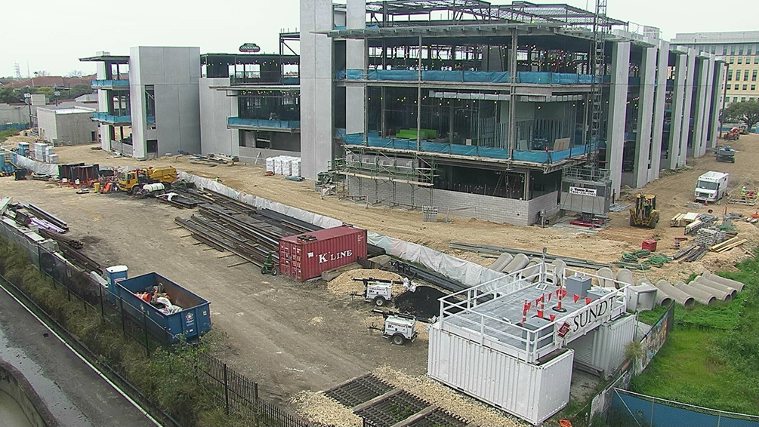
Partner Coordination
Phases 1 and 2 Coordination ongoing
Camaron Street – 70% design
TPR/Alameda – In operation
Commerce Street – Design moving forward
Linda Pace Foundation/Ruby City
UTSA downtown campus expansion
GSA/Federal Courthouse
SAISD Administration building

Slide 13
Partner Coordination
Executive Committee
David Smith, County Manager, Bexar County
Lori Houston, Assistant City Manager, City of San Antonio
Razi Hosseini, Director, Transportation and Capital Improvements, City of San Antonio
Suzanne Scott, General Manager, San Antonio River Authority
Next Meeting date: March 13

Slide 14
QUESTIONS
& COMMENTS

