Slide 1


Slide 2
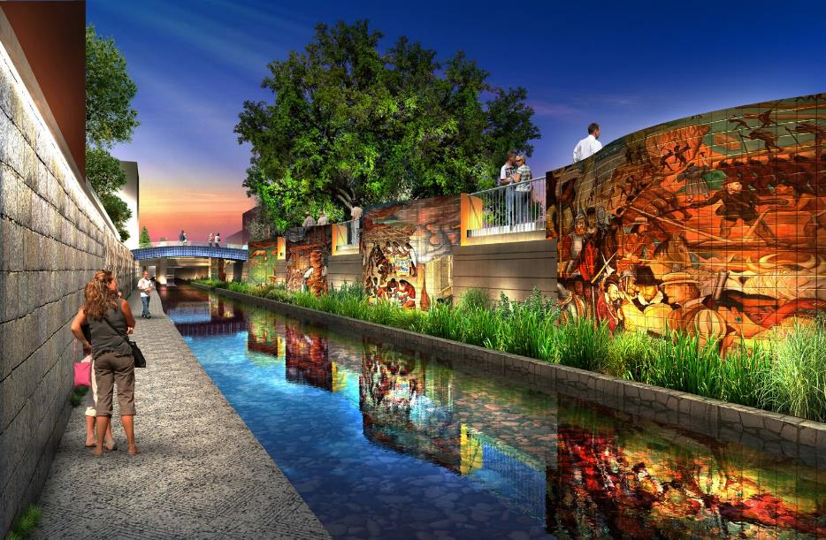
PHASE 1.2: Five Panel Mural
Artwork Goals:
Be compelling and aesthetically excellent
Incorporate participation from the community into the design of the artwork
Celebrate the cultural diversity of the creek and its connection to San Antonio’s and Bexar County’s origin stories
Create excitement and interest from the community and culture park visitors
Endure the climate of this area, the flooding nature of the creek and a variety of linear park public uses
Notes:
Opportunity open to San Pedro Creek Pre-Qualified Artist Pool

Slide 3
PHASE 1.2: Five Panel Mural
Schedule:
September 24, 2019 – RFQ released
October 23, 2019 – RFQ deadline
  24 applications received
January 7, 2020 – Selection Panel reviewed applications
  Four finalists selected; three moving forward
February 13, 2020 – Finalist Interviews
February 19, 2020 – Selection results presented to SARA Board of Directors
Selection Panel Members:
Bianca Alvarez, Teresa Eckmann, Juanita Fierro, Belinda Gavallos, Ben Tremillo
Notes:
Five states: CA, GA, NY, TX, WA
58% from TX

Slide 4
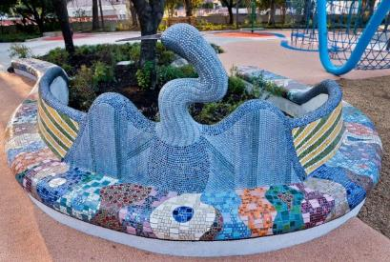
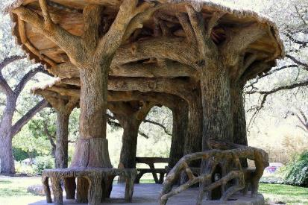
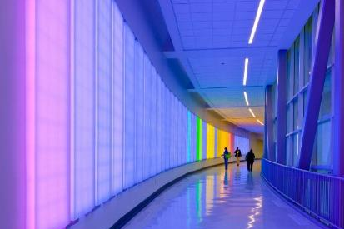
PHASE 1.2: Five Panel Mural
Finalists:
Oscar Alvarado + Armando Rubio, Jacinto Guevara, Albert Alvarez
Carlos Cortes + Rolando Briseno, Fernando Andrade, Jenell Esparza, Ernesto Ibanez
Ansen Seale + Doerte Weber, Mari Hernandez

Slide 5
PROJECT UPDATES
Creek Lines by Bridge Projects (Ph 1.1)
Steady progress on engineering and installation plan
Fabrication to begin this spring; fall 2020 installation
Stream by Adam Frank (Ph 1.2)
Finalized microphone location and site design; developing sculpture design
Developing software program with spec’d lights and controller
Water Wall test mid-April

Slide 6

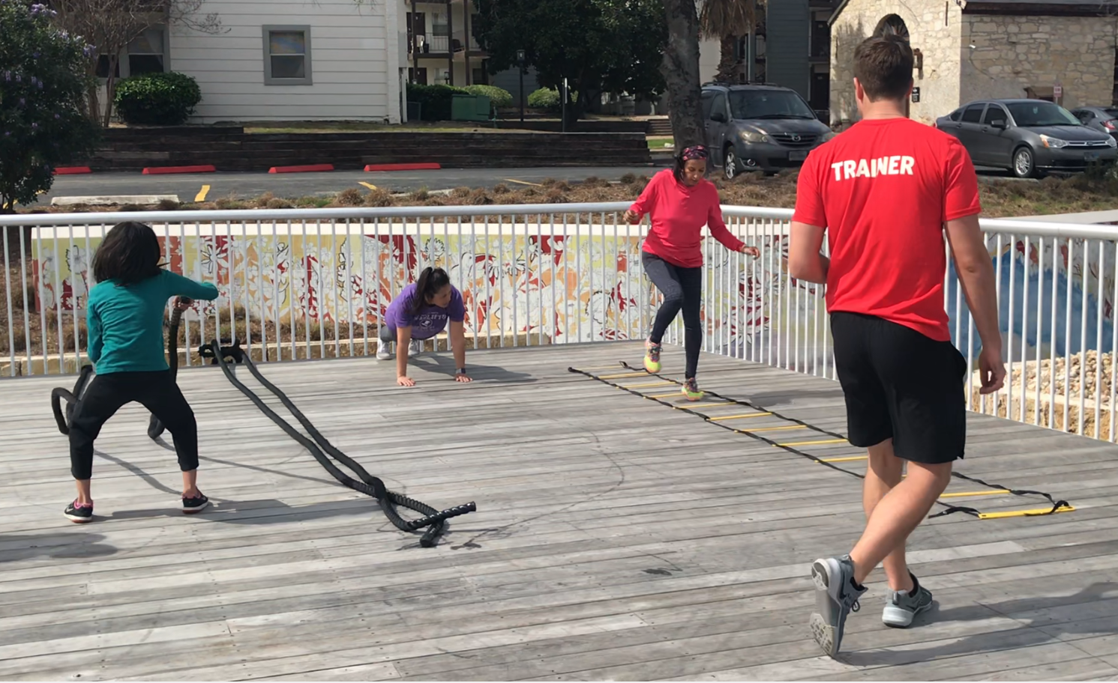
EVENTS
Saturday, February 22
9 a.m. – 1 p.m.
Free fitness demo classes
Mobile Fit Bus
Wellness vendors
Membership giveaways; raffles
Healthy food sampling
Pedometer Giveaway
Notes:
Free fitness demo classes
Mobile Fit Bus
Wellness vendors
Membership giveaways
Healthy food sampling

Slide 7


EVENTS
2nd Tuesdays, 7pm
(Quarterly)
Mondays, 6pm
(March-October)
Notes:
Free fitness demo classes
Mobile Fit Bus
Wellness vendors
Membership giveaways
Healthy food sampling

Slide 8
QUESTIONS?

