Slide 1
February 13, 2020

Slide 3
Updates
Phase 1.2
Construction activities
Phases 1.3 and 2
Design Activities
Partner Coordination

Slide 4
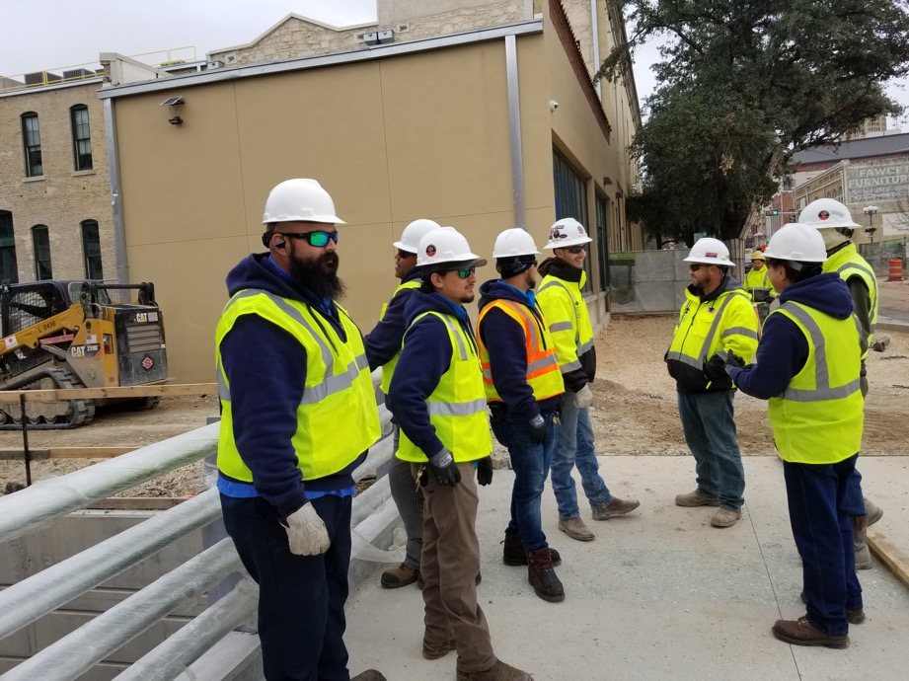
Phase 1.2 Construction
Houston to Commerce
Houston street bridge
Utility Installation
Plaza paving
Commerce to Dolorosa
Dolorosa street bridge
Swap to south side
Low bank paseo
Dolorosa to Nueva
Channel wall construction
UTSA coordination

Slide 7
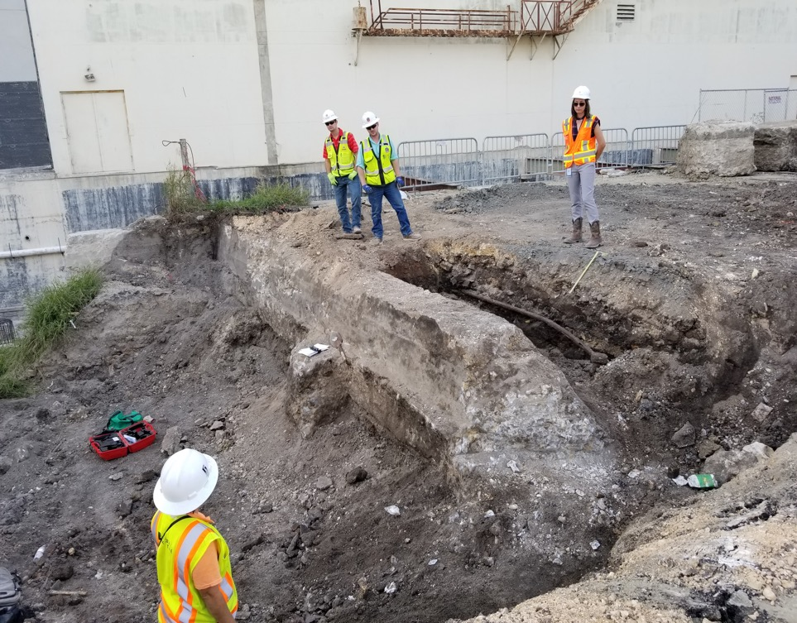

Slide 9
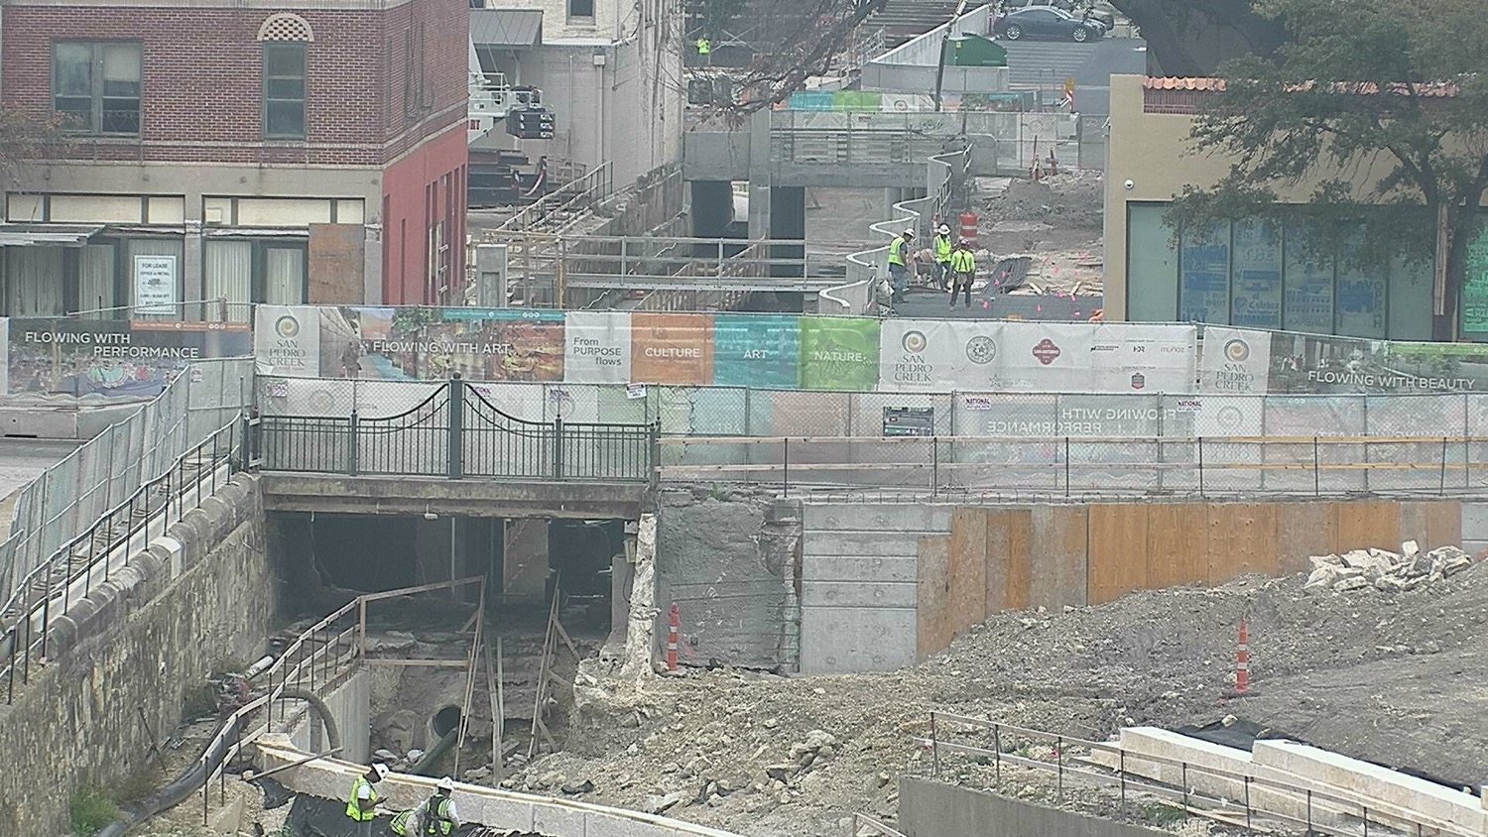

Slide 11
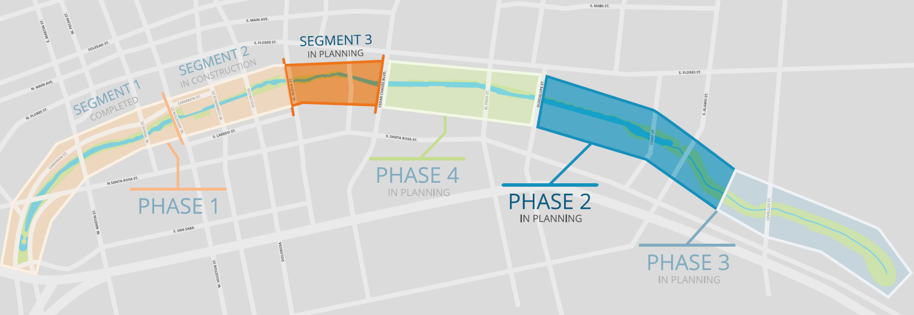
Phase 1.3 and Phase 2

Slide 12
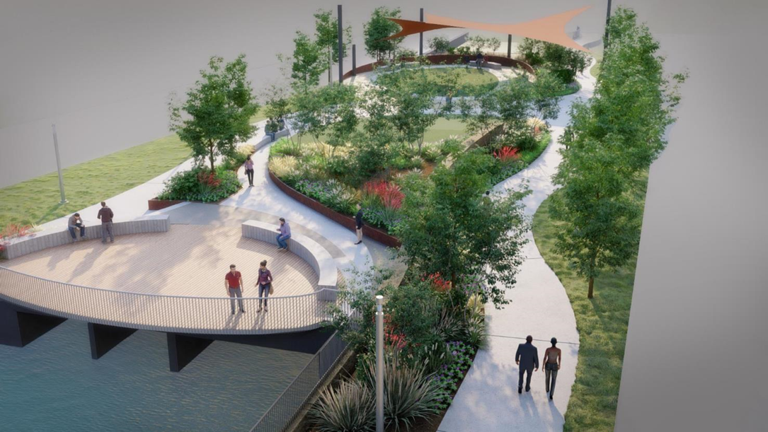
Phase 1.3 and Phase 2 Design
Design ongoing
ROM cost estimate February 21
March 2020: Construction start
July 2020: 100% completion full design
September 2020: Guaranteed Maximum Price from CMAR

Slide 13
Partner Coordination
Phases 1 and 2 Coordination ongoing
SAISD Administration building
UTSA downtown campus
TPR/Alameda
Commerce Street
GSA/Federal Courthouse
TxDOT
Linda Pace Foundation/Ruby City
CPS Substation
Camaron Street

Slide 14
Partner Coordination
Executive Committee
David Smith, County Manager, Bexar County
Lori Houston, Assistant City Manager, City of San Antonio
Razi Hosseini, Interim Director, Transportation and Capital Improvements, City of San Antonio
Suzanne Scott, General Manager, San Antonio River Authority
Next Meeting date: March 13

Slide 15
QUESTIONS
& COMMENTS

