Slide 1
August 8, 2019

Slide 3
Updates
Phase 1.2
Construction activities
Phases 1.3 and 2
Commissioners Court approvals
Partner Coordination

Slide 4
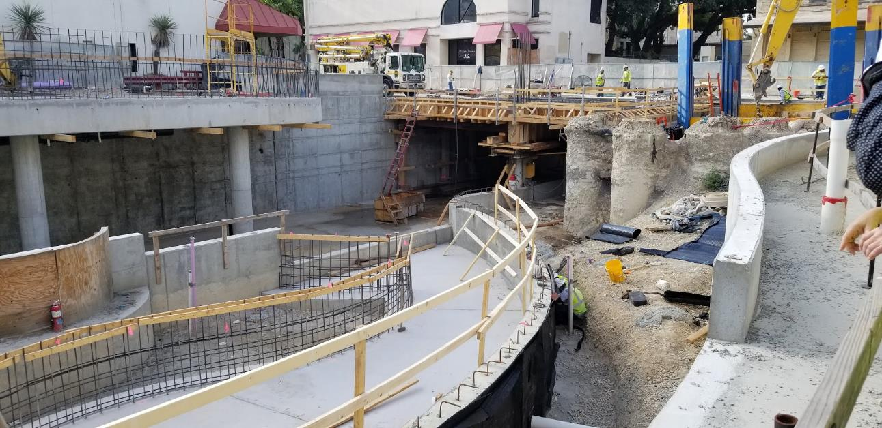
Phase 1.2 Construction
Houston to Commerce
Concrete pours
Waterwall construction
Commerce to Dolorosa
Concrete pours for channel bottom
Dolorosa to Nueva
Channel excavation
Concrete pouts

Slide 5
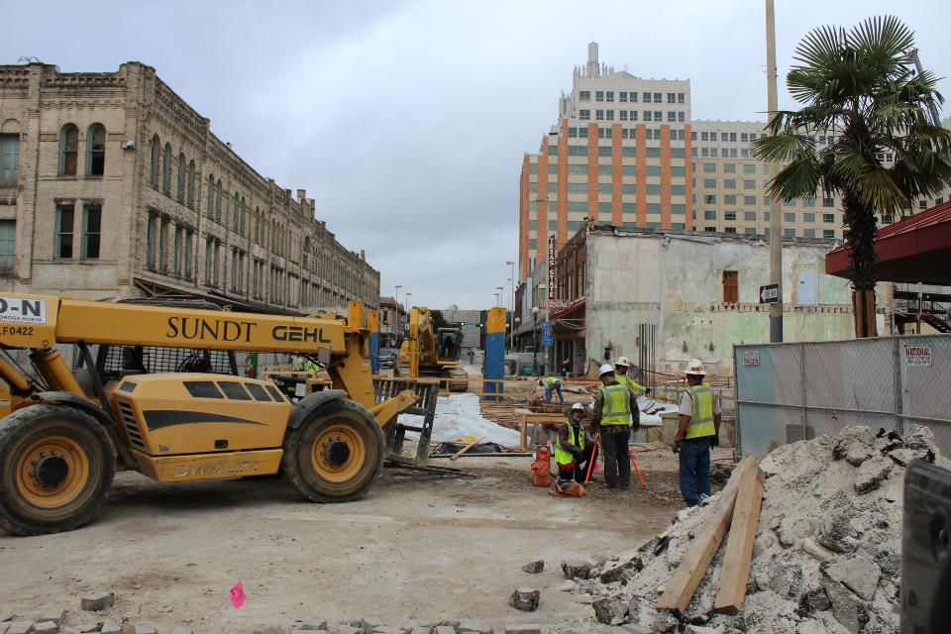
Phase 1.2 Construction
Commerce Street Bridge
All vehicle lanes closed
South lane reopened mid-September
October completion
Dolorosa Street Bridge
Demolition of north half of bridge started
Traffic will be reduced to one lane until April 2020

Slide 9
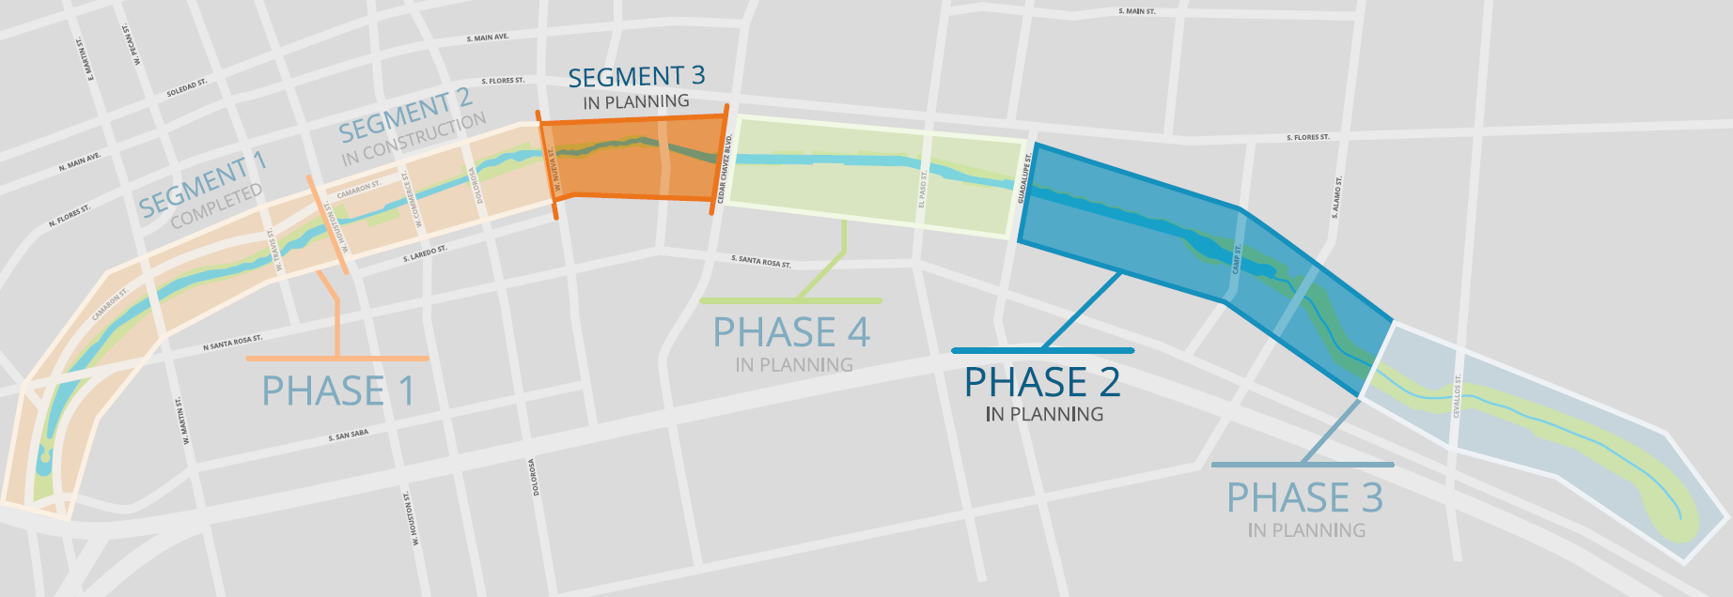
Phases 1.3 and 2 Design

Slide 10
Phase 1.3 and Phase 2 Design
Design concepts and renderings presented to Commissioners Court June 18
Approval of design and construction funding
Design planning and coordination ongoing

Slide 11
Partner Coordination
SAISD administration building
Alameda Theater
Texas Public Radio
Construction coordination ongoing
UTSA downtown campus expansion
East bank design coordination

Slide 12
Partner Coordination
Commerce Street
Design under revision to include bike lanes
Federal Courthouse (GSA)
Ongoing design and construction coordination meetings held

Slide 13
Partner Coordination
Executive Committee
David Smith, County Manager, Bexar County
Lori Houston, Assistant City Manager, City of San Antonio
Razi Hosseini, Interim Director, Transportation and Capital Improvements, City of San Antonio
Suzanne Scott, General Manager, San Antonio River Authority
Next Meeting – August 16

Slide 14
QUESTIONS
& COMMENTS

