Slide 1
June 13, 2019

Slide 3
Updates
Phase 1.1 activities
Phase 1.2
Construction activities
Partner coordination
Phases 1.3 and 2
Design Activities
Renderings

Slide 4
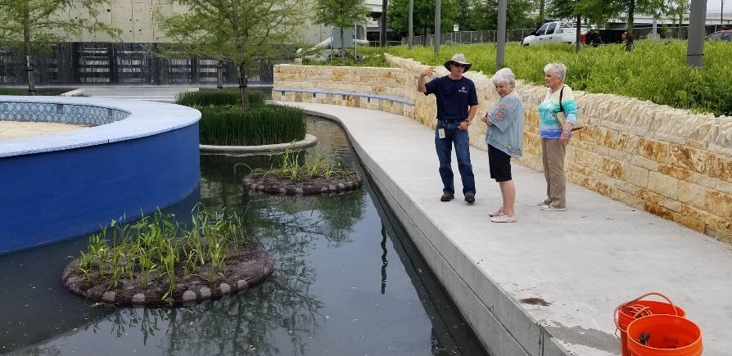
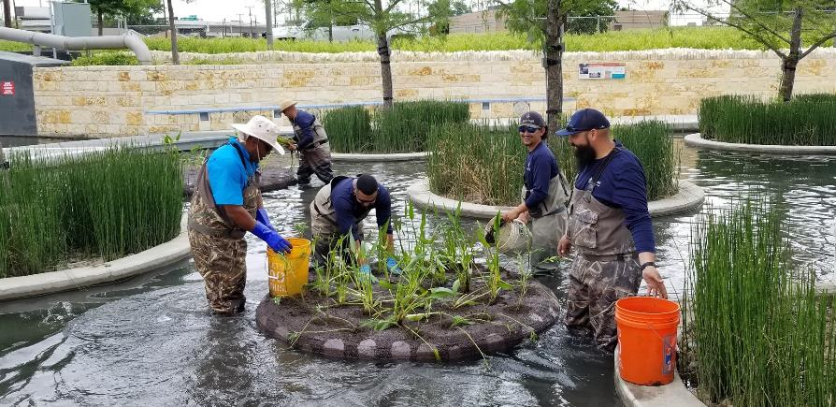
Phase 1.1 activities
Manantial tile
Many tiles delaminated
Samples taken for testing to determine cause
All tiles removed until cause is determined
Floating islands
Provide additional aquatic plantings in manantial area
Improved water quality

Slide 5
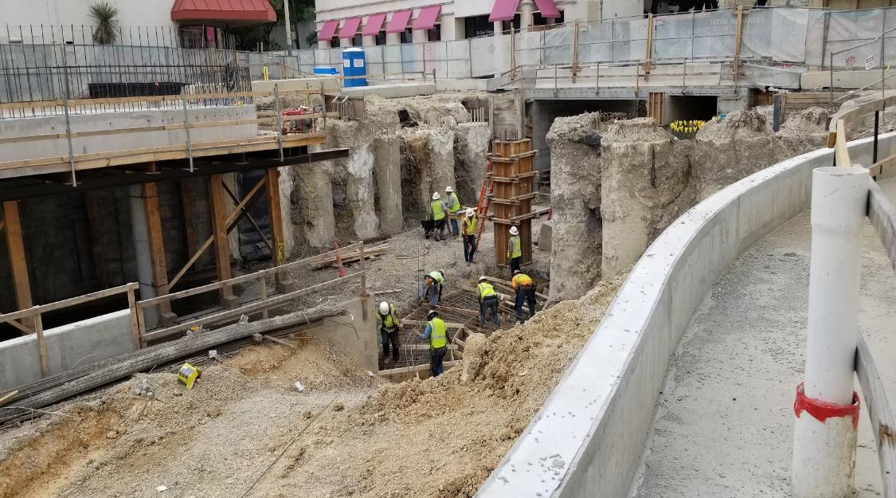
Phase 1.2 Construction
Houston to Commerce
Concrete pours for channel bottom and walls
Penner’s parking deck
Commerce to Dolorosa
Channel slab excavation
Dolorosa to Nueva
Soil nail wall installation

Slide 6
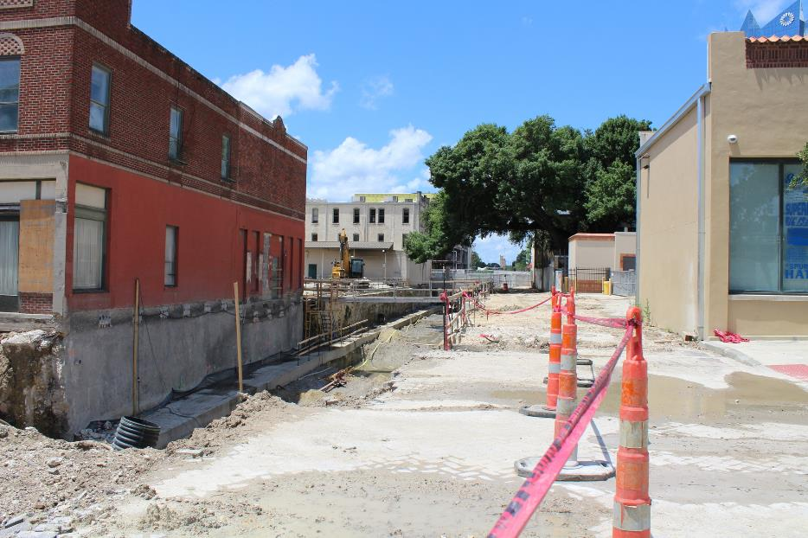
Phase 1.2 Construction
Commerce Street Bridge
Full closure postponed until July 29
South lane reopened mid-September
Dolorosa Street Bridge
Demolition of north half of bridge started
Traffic will be reduced to one lane until April 2020

Slide 10
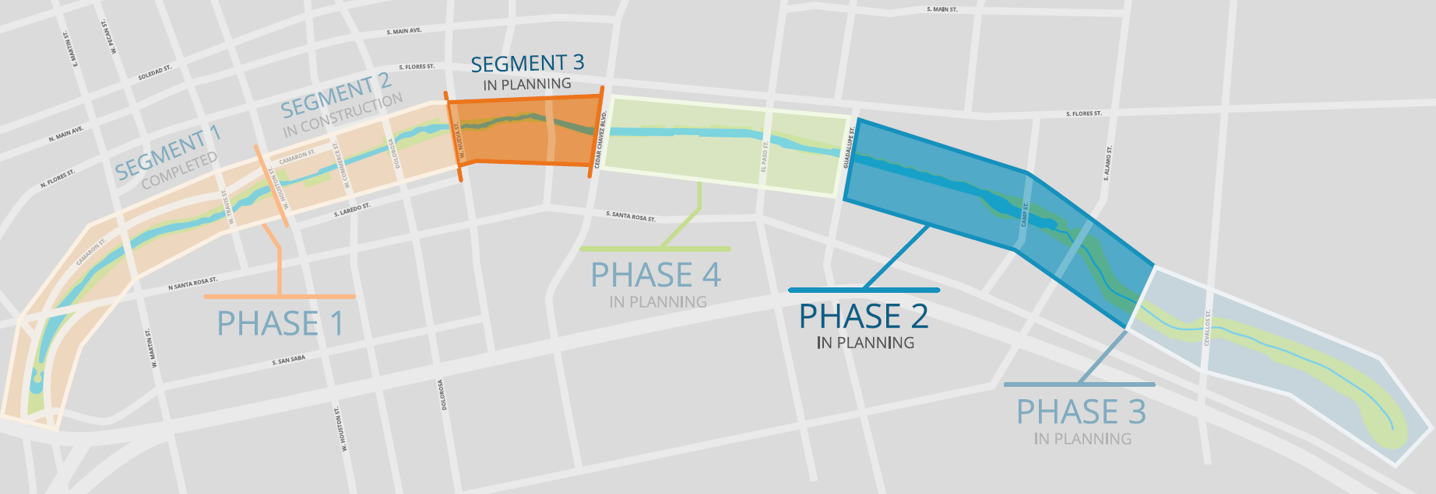
Phases 1.3 and 2 Design

Slide 11
Phase 1.3 and Phase 2 Design
Design concepts and renderings to be presented to Bexar County Commissioners Court June 18
Approval for construction funding will be requested

Slide 18
Partner Coordination
SAISD administration building
Camaron Street construction
Travis to Houston block completed
Remainder to begin in late 2019
Alameda Theater
Texas Public Radio
Coordination ongoing

Slide 19
Partner Coordination
Commerce Street
Construction start postponed until October
UTSA downtown campus expansion
Coordination ongoing
Federal Courthouse (GSA)
Design and construction coordination meetings held
LID coordination

Slide 20
Partner Coordination
Executive Committee
David Smith, County Manager, Bexar County
Lori Houston, Assistant City Manager, City of San Antonio
Razi Hosseini, Interim Director, Transportation and Capital Improvements, City of San Antonio
Suzanne Scott, General Manager, San Antonio River Authority
Next Meeting – TBD

Slide 21
QUESTIONS
& COMMENTS

