Slide 1
February 14, 2019

Slide 2
Interpretive Plan Update
Next Committee Meeting – Feb 27
2:30-4:30pm
Individual Meetings with Anne
History
Ecological
Design Team
Interpretive Signage

Slide 3
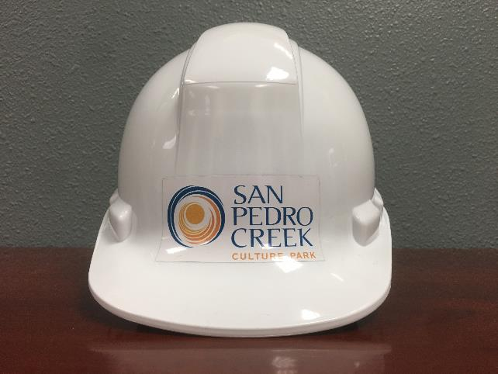
SPC Outreach
Media Tour with Commissioner Justin Rodriguez & Judge Wolff
Feb 15 – 10am-12pm
Phase 1.2 Stakeholder Mixer
Early March
Phase 1.2 Public Meeting
Late March
Phase 1.2 Construction Tours
Quarterly – Starting in March
Newly branded PPE gear

Slide 5
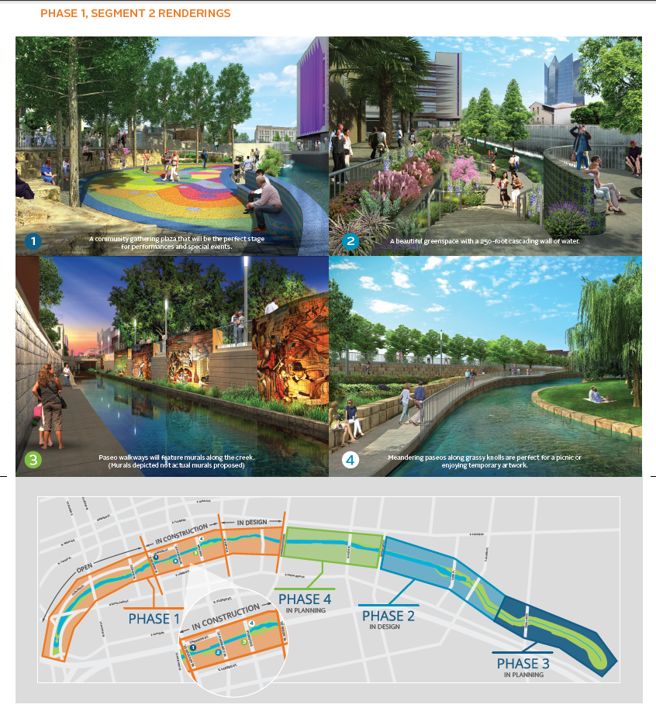

Slide 6
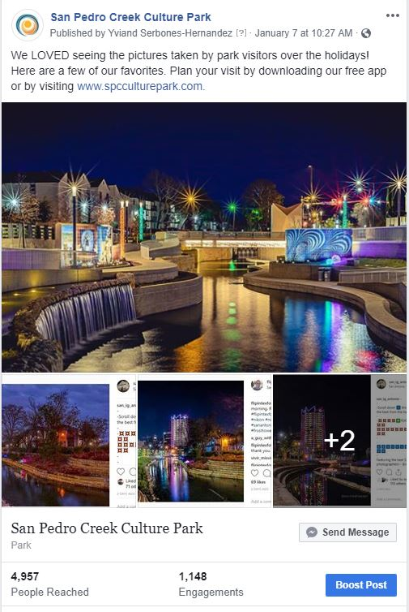
Social Media – 3rd Quarter
Facebook
- 6,911 (131 increase)
- 323,400 impressions
- 1,947 engagements
Twitter
- 1,174 (45 increase)
- 21,400 impressions
- 342 engagements
Instagram
- 2,609 (83 increase)
- 831 likes received
- 24comments received

Slide 7
QUESTIONS

