Slide 1
February 14, 2019

Slide 3
Updates
Phase 1.1
Remaining items
Phase 1.2
Construction activities
Partner coordination
Additional Funding
Phases 1.3 and 2
Design Activities

Slide 4
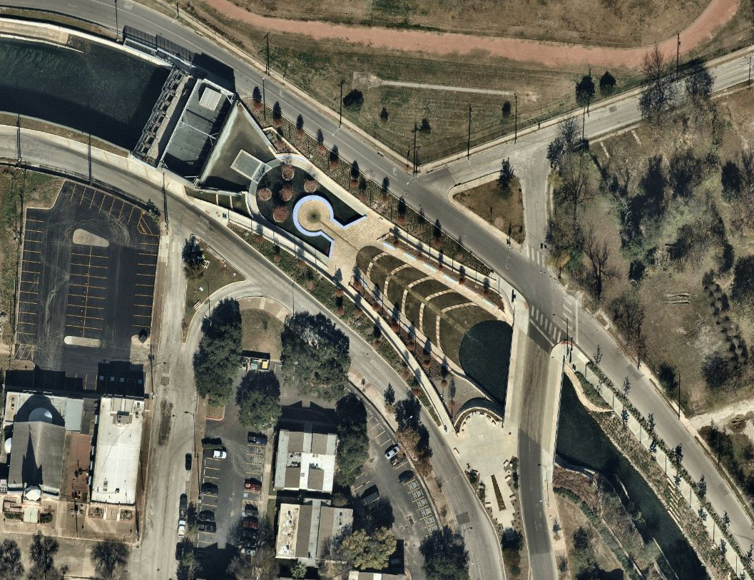
Phase 1.1 Remaining Items
Additional railing at Travis Gatehouse
Installation to begin in late February
Inlet lighting
Trash screen at inlet pump station
Santa Rosa Pedestrian Crossing

Slide 5
Phase 1.2 Construction
Early Work Package 11: Demolition and utility relocation
Water & gas work on Dolorosa ongoing
Three north lanes closed for 6-8 weeks
Early Work Package 12: Heavy civil construction
Drilled shaft installations between Commerce and Nueva
Concrete pours in Houston to Commerce block
Early Work Package 13: Commerce Street bridge deck and Penner’s parking
Bridge deck being constructed

Slide 12
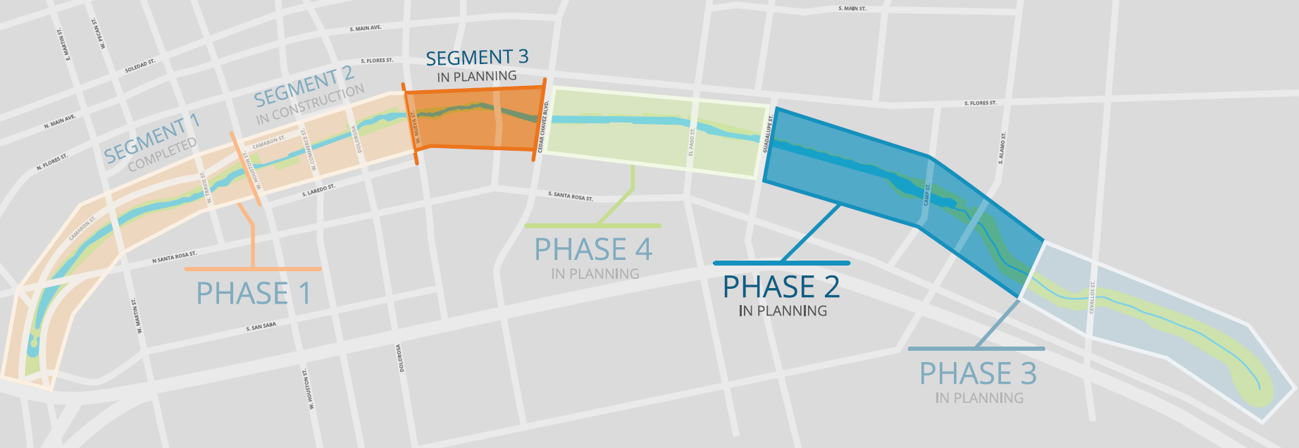
Phases 1.3 and 2 Design

Slide 13
Phase 1.3 and Phase 2 Design
Kickoff meeting held on January 17
Design guidelines established
Value Engineering efforts ongoing
Mario Schjetnan to be engaged to review and consult
Desired design completion October 2019

Slide 14
Partner Coordination
SAISD administration building
SARA/SAISD coordination
Camaron Street construction
COSA 95% plans provided to contractor
Travis to Houston block to be completed in May
Remainder to begin in late winter 2019
Alameda Theater
Project team coordination
Texas Public Radio
Demolition started
Coordination ongoing

Slide 15
Partner Coordination
Commerce Street
Construction Proposals under review
Construction to begin May/June
UTSA downtown campus expansion
SPC design files shared
Coordination meeting to scheduled
Federal Courthouse (GSA)
Coordination ongoing

Slide 16
Partner Coordination
Executive Committee
David Smith, County Manager, Bexar County
Lori Houston, Assistant City Manager, City of San Antonio
Razi Hosseini, Interim Director, Transportation and Capital Improvements, City of San Antonio
Suzanne Scott, General Manager, San Antonio River Authority
Next Meeting – February 27

Slide 17
QUESTIONS
& COMMENTS

