Slide 1
September 13, 2018

Slide 2
Operations and Maintenance
Plaza de Fundación
Storm Response
Motorized Vehicles

Slide 3
Plaza de Fundación
Recent rain events have caused the bacteria levels in the creek to spike.
The plaza water is being managed for water quality sampling.
During this time, samples are taken daily to determine if the bacterial levels are in an acceptable range.
Typically, samples are taken every Wednesday and recorded on the SARA website.

Slide 4
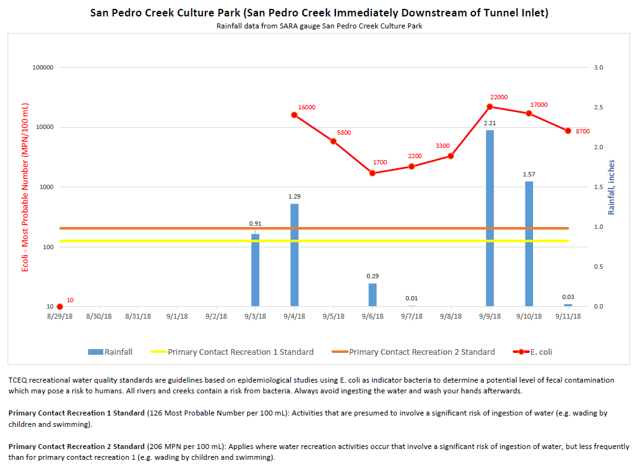
Notes:
Plaza is isolated after the San Pedro Creek rain gauge measure .25”. The rain gauge is located @ the SPC tunnel inlet.

Slide 5
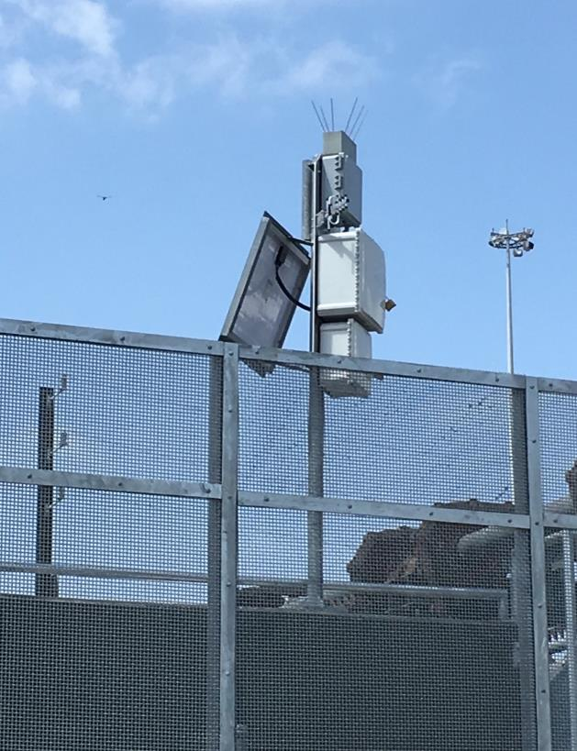

Slide 6
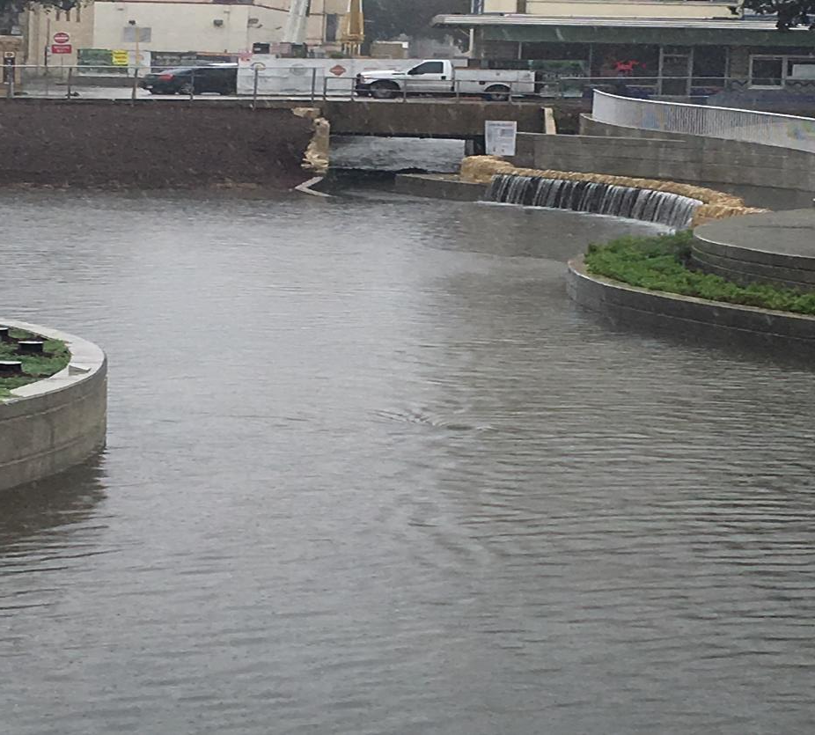
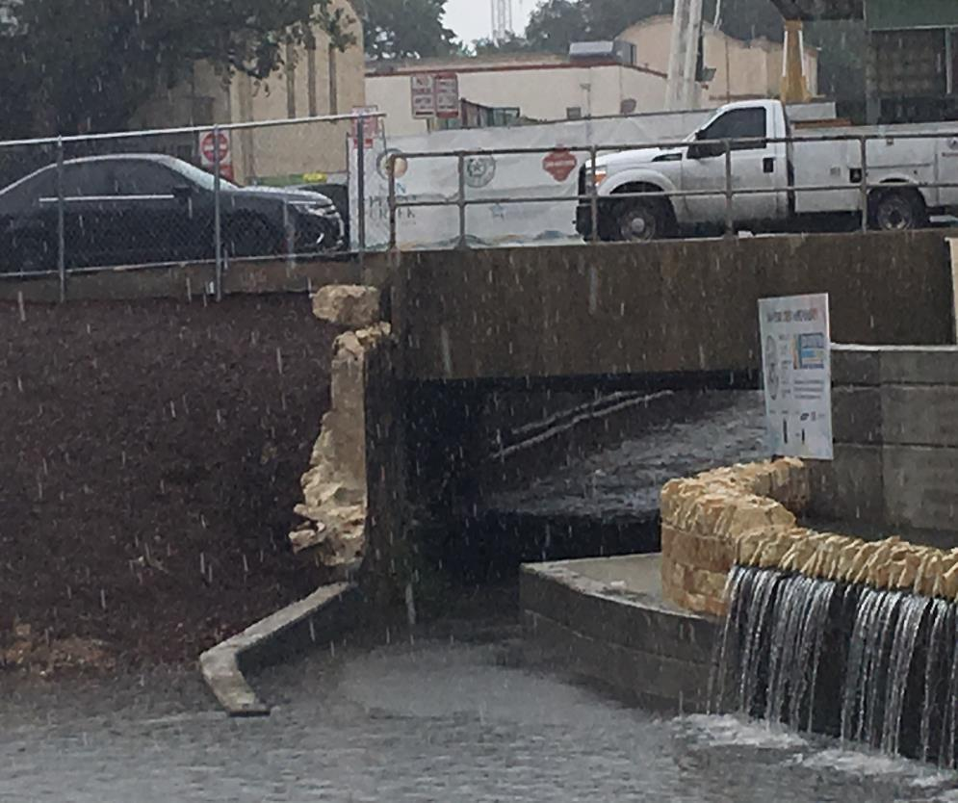

Slide 7
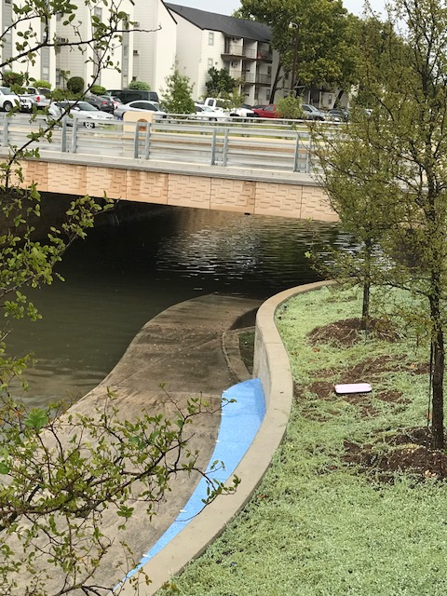
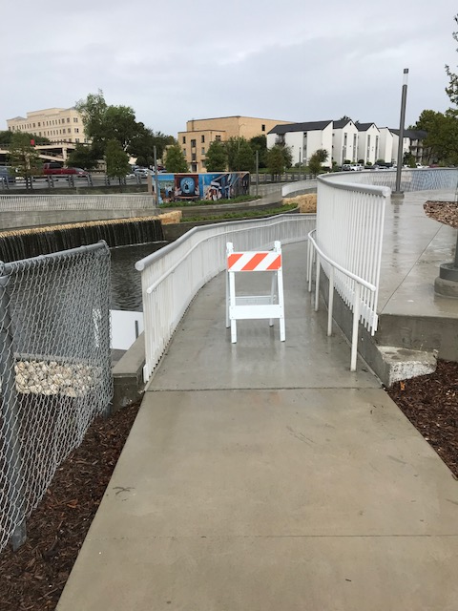

Slide 8
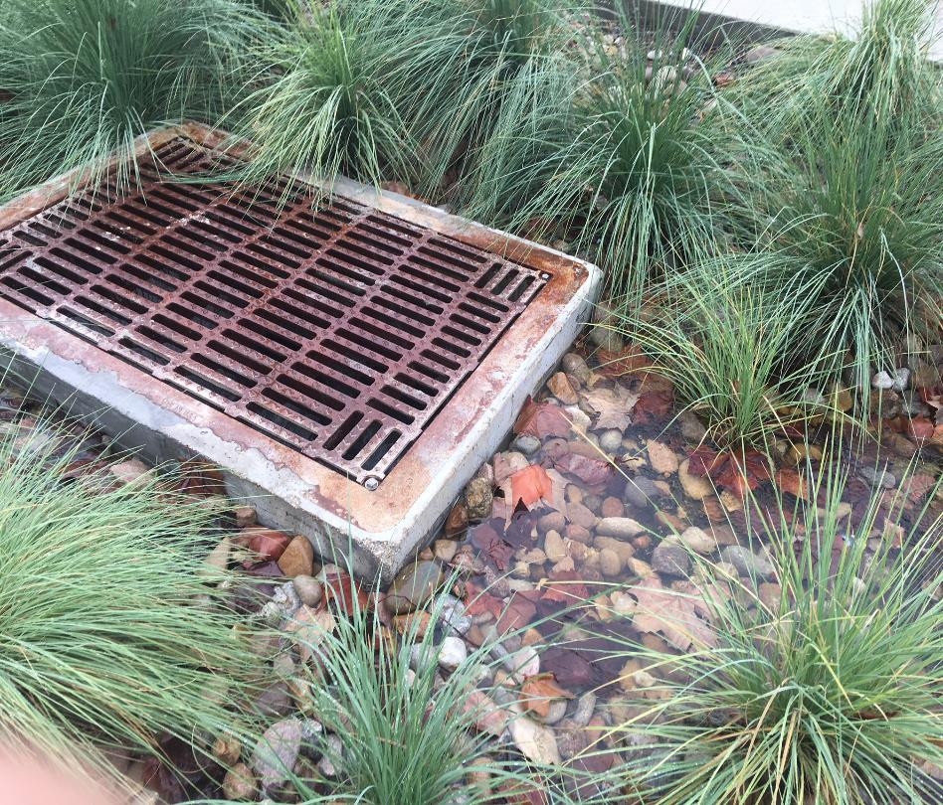

Slide 9
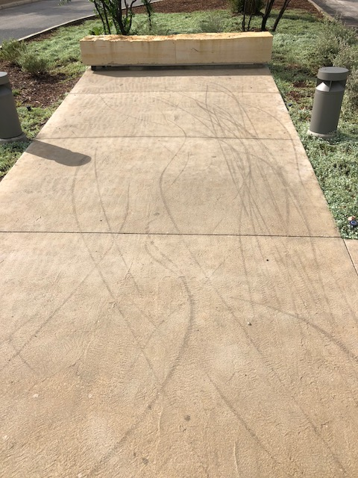
Motorized vehicles
Dockless Scooters
SARA has been part of public and stake holder meetings
The Transportation Committee heard a briefing from City officials on regulating the scooters
At this time, under city code Sec. 22-4-1, motorized vehicles are not allowed in city parks or on trails
Geo Fencing
Increased operations and maintenance

Slide 10
QUESTIONS

