Slide 1
Sept 13, 2018

Slide 2
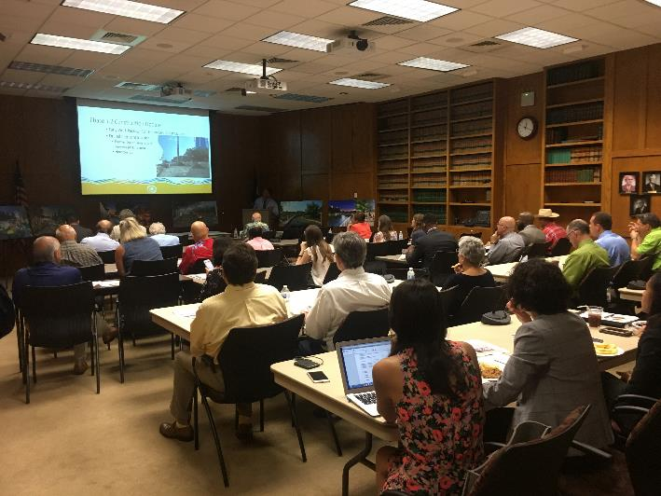
Design Workshop Recap
Attendance: 38
Key Takeaways
Lighting and signage
Kid friendly
Artist selection
Next Steps
Sept 14
- Executive Committee Review
Sept 18
- Judge & Commissioner Briefing
Oct 2
- Commissioner’s Court

Slide 3
Interpretive Plan Update
Contract with Toxey/McMillan & Associates
Email out to committee today
Committee meetings tentatively planned for:
Oct 1st
Oct 29th
Nov 19th

Slide 4
Website Updates
Goes live 9/17
Better user experience
Cleaner look and feel
Updated navigation
New photos
http://spcculturepark.staging.wpengine.com/

Slide 5
Spanish Translations
Sneak peek
Website & Mobile App audio tour
New, user friendly stickers

Slide 6
Questions

