Slide 1
June 14, 2018

Slide 2
Operations and Maintenance
Plaza de Fundación
Algae
Houston/Travis Grate
Trail Monitoring

Slide 3
Plaza de Fundación
Re-opened Thursday, June 21st

Slide 4
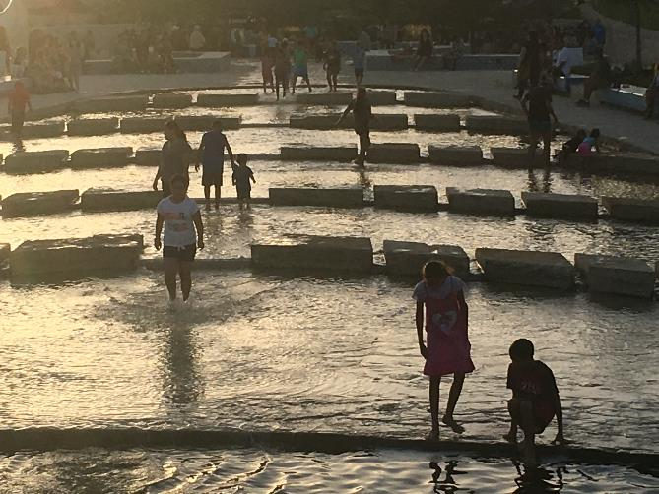
Plaza de Fundación
Watershed and Park and Operations are now responsible for the water diversion in the Plaza de Fundacion.
We regulate the valves that control the Rains from Heaven, the Manantial, the Cascadia and the Main Channel

Slide 5
Plaza de Fundación
Recent rain events have caused the bacteria levels in the creek to spike.
The plaza water is being managed for water quality sampling.
During this time, samples are taken more frequently to determine if the bacterial levels are in an acceptable range.
Typically, samples are taken every Wednesday and recorded on the SARA website.

Slide 6
https://spcculturepark.com/visit/plan-your-visit/

Slide 7
Algae
Short Term Solution
The initial treatment of hydrogen peroxide place on June 20th.
Liquid hydrogen peroxide and granules were applied throughout the channel.
Overall successful

Slide 8
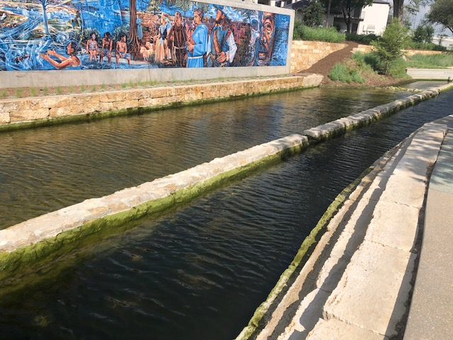

Slide 9
Algae- Alum Treatment
Aluminum sulfate Treatment
Longer term solution
Used to reduce the amount of phosphorus in the water
Binds to phosphorus which then can no longer be utilized by algae organisms.
Other opportunities ongoing-Natural process of the channel, charcoal addition.

Slide 10
Houston/Travis St Grate
Algae/debris accumulating on the inlet grate
Interim grate modification, long term solutions
Impacts to lower paseo

Slide 12
Trail Monitoring
Inundation of the lower paseo from Travis to Houston
Short term management-cleaning of the grate
Barricade and cleaning of the paseo

Slide 13
QUESTIONS

