Slide 2
San Pedro Creek Status Update
Phases 1.1 and 1.2 Construction
Phase 1.2 Design
Phase 1.2 Design and Construction timelines
Project Partner Coordination

Slide 3
PROJECT PHASING

Slide 4
DESIGN ENHANCEMENTS
CONSTRUCTION UPDATE

Slide 5
Phase 1.1 Construction Update
Sundt-Davila JV on schedule to complete construction of Phase 1.1 by May 5, 2018
Flagstone in manantial area
Limestone for 12 generation benches and in pools
Landscaping in Santa Rosa to Martin block
Travis Gatehouse concrete poured
Last public construction tour conducted on February 2

Slide 7
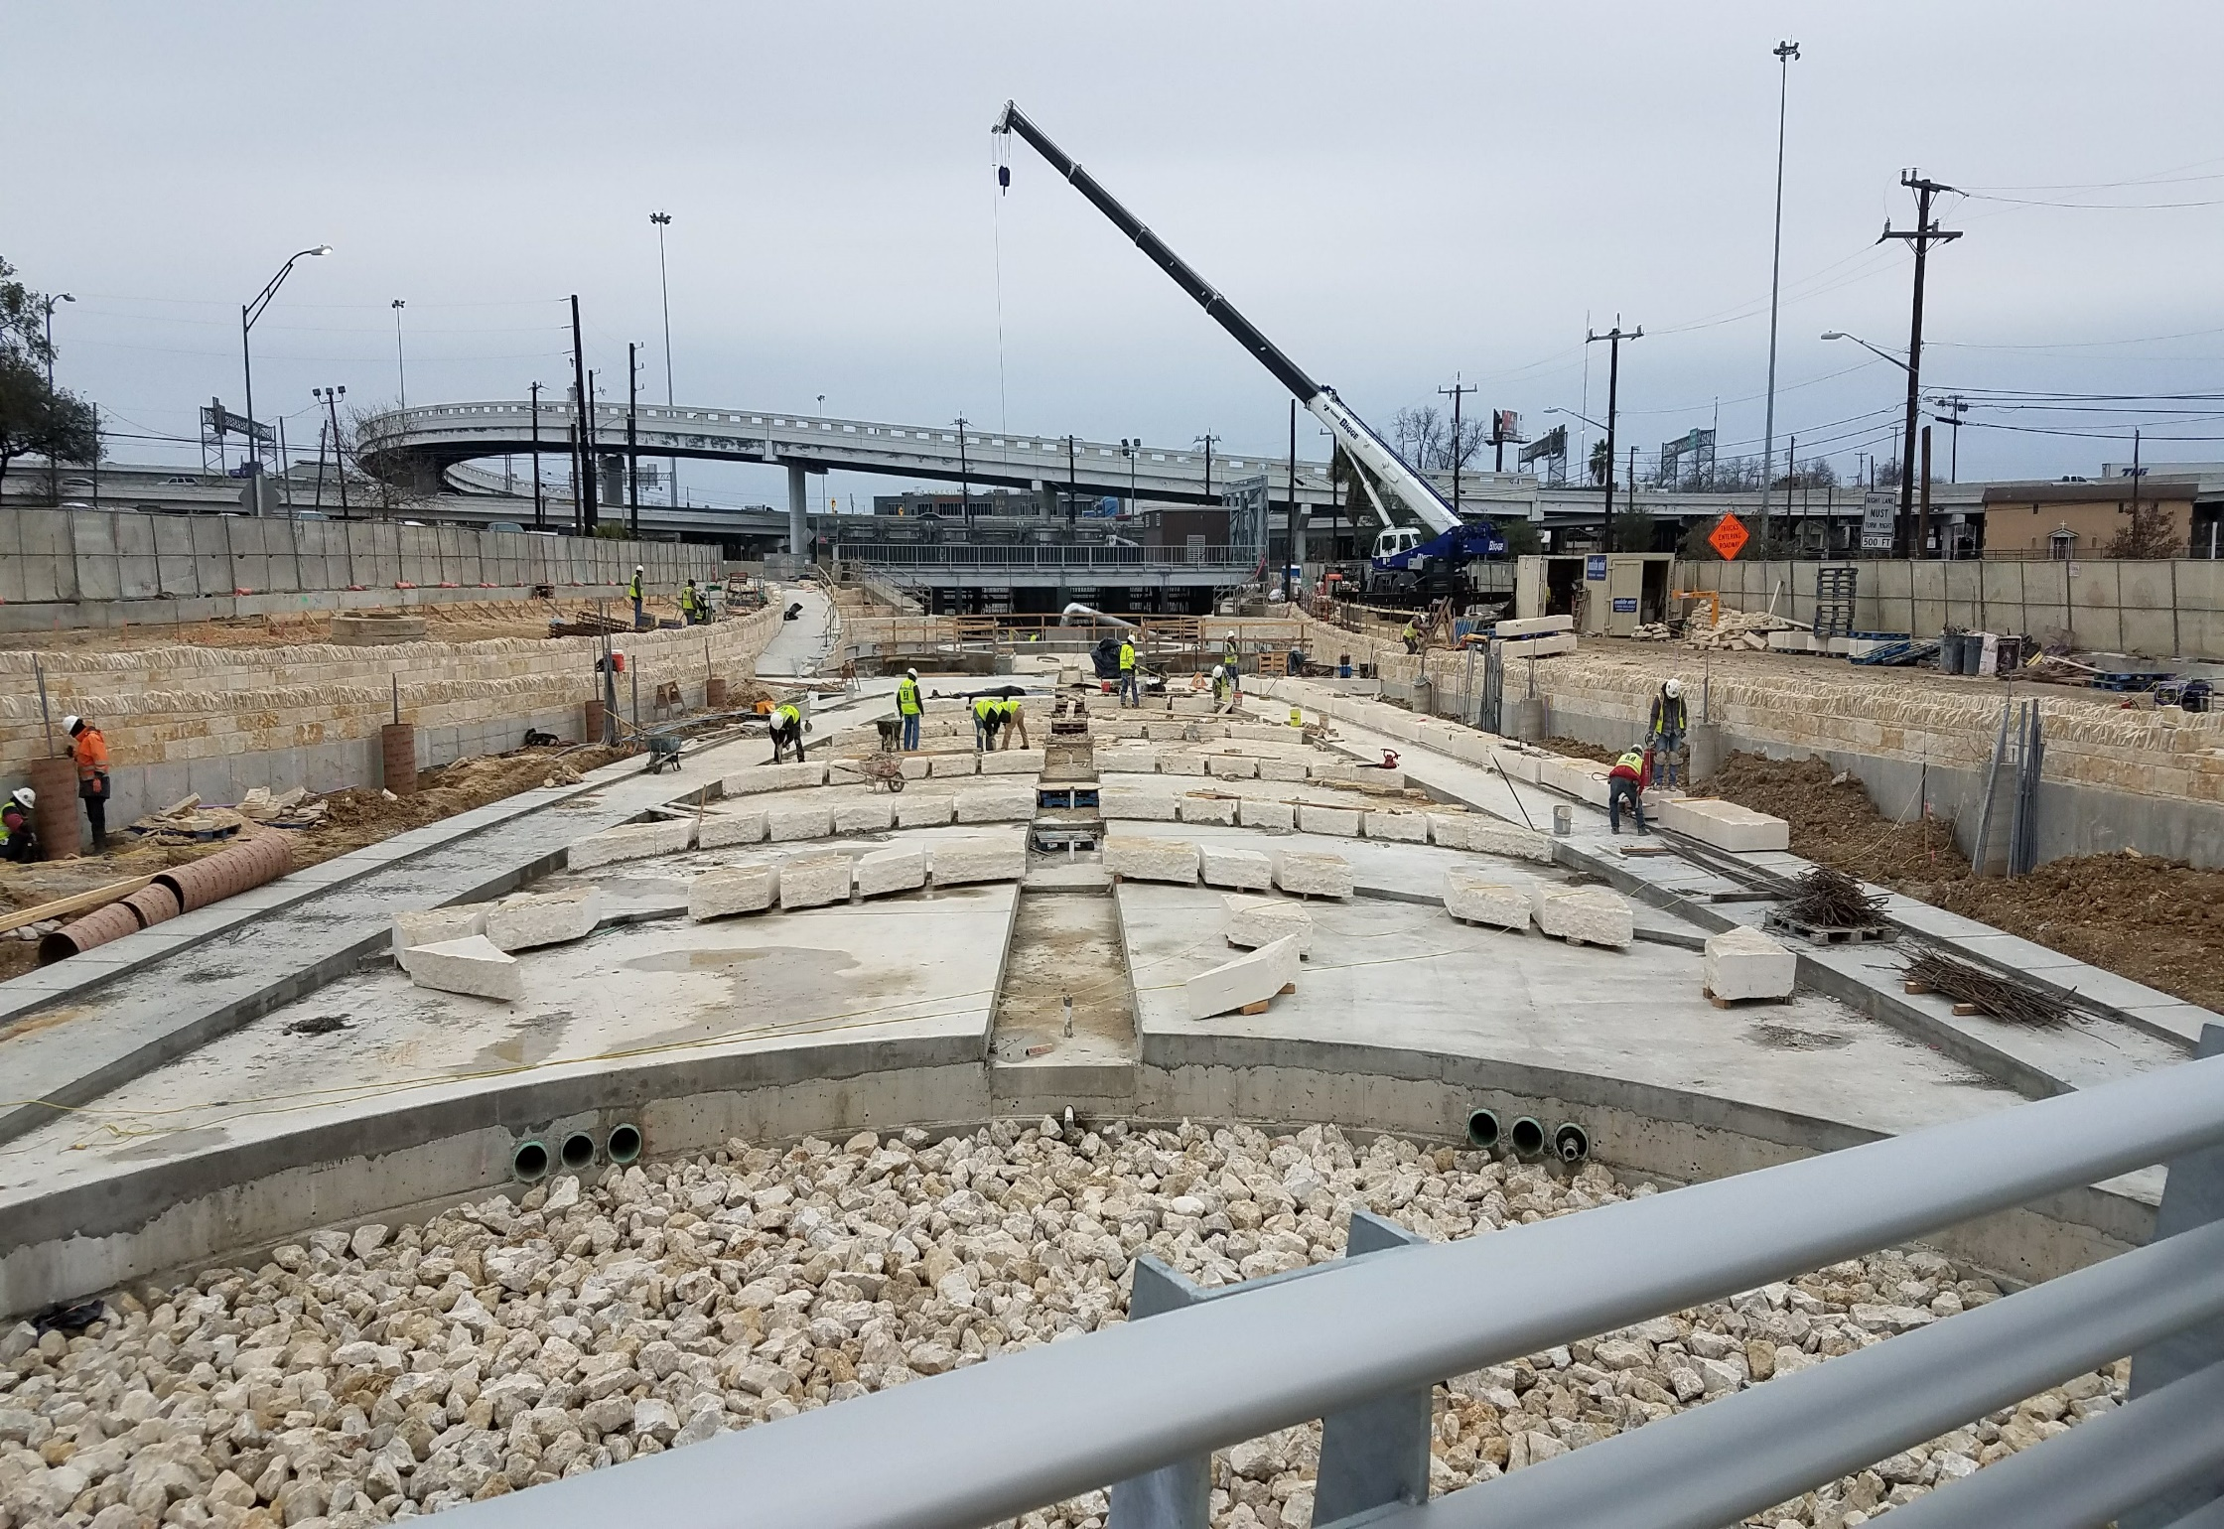

Slide 8
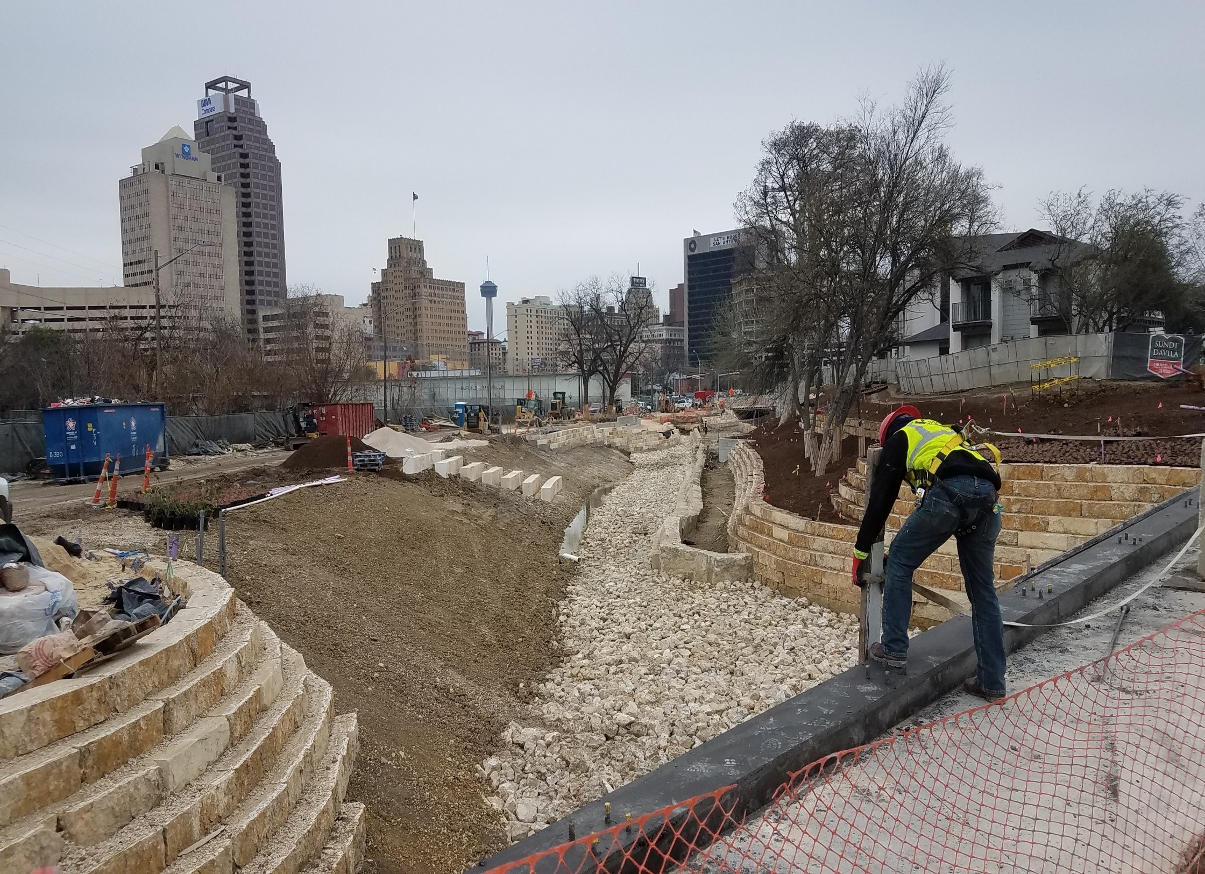

Slide 9
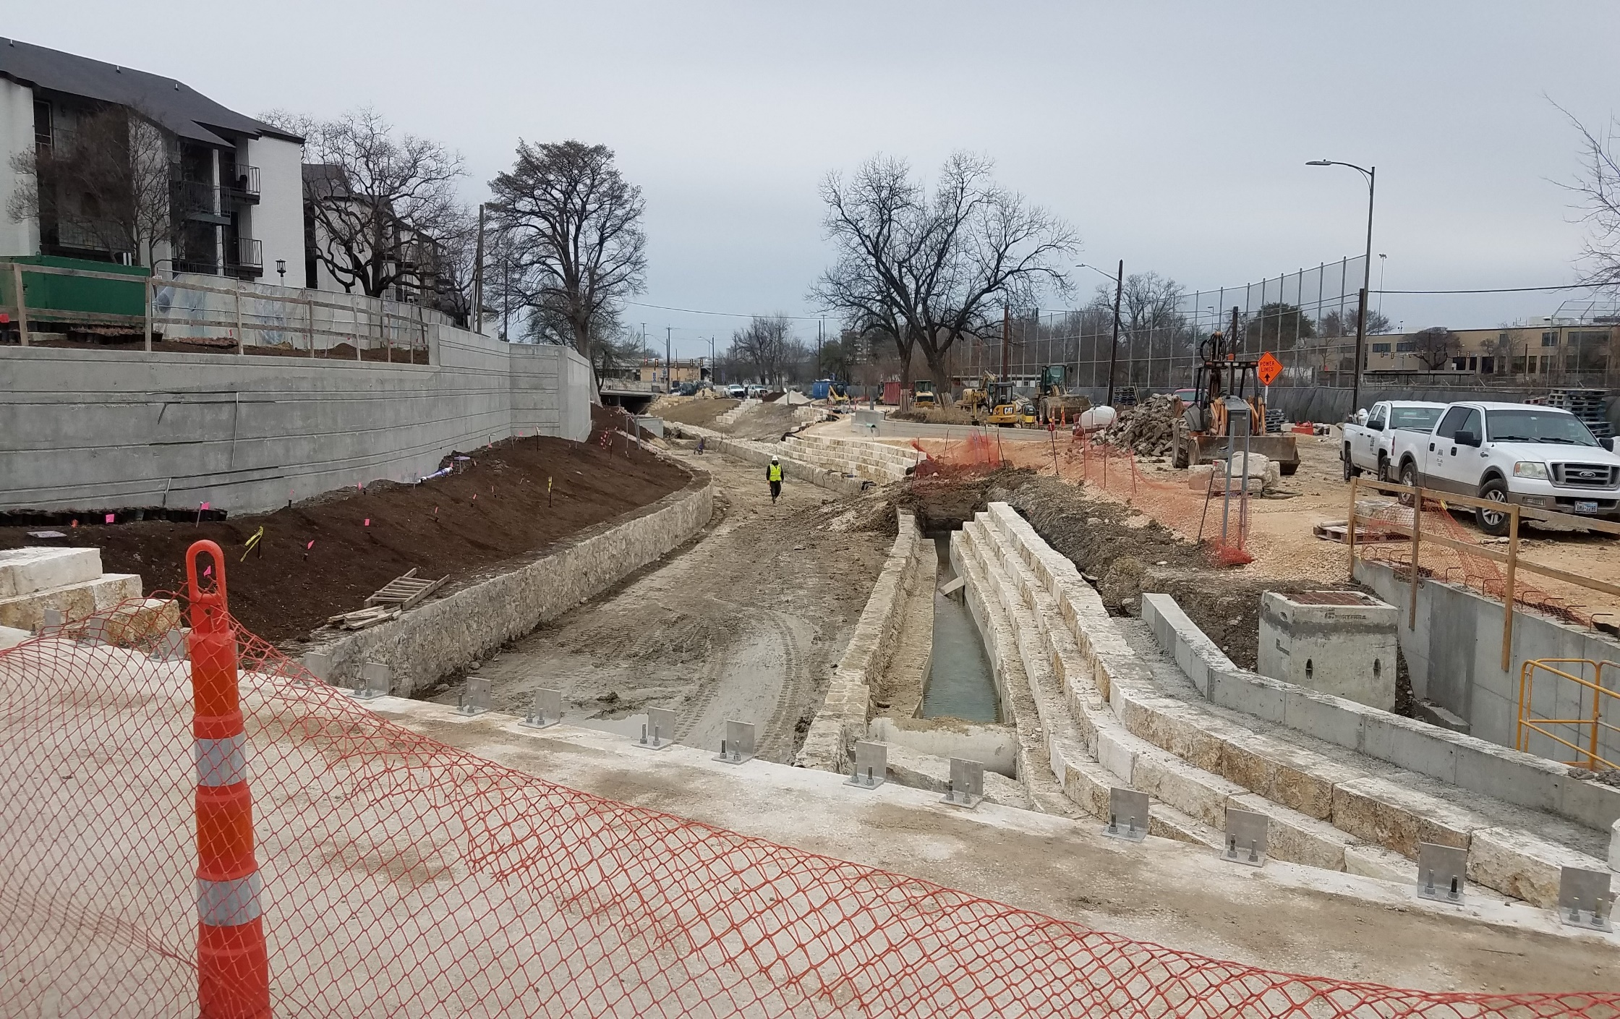

Slide 10
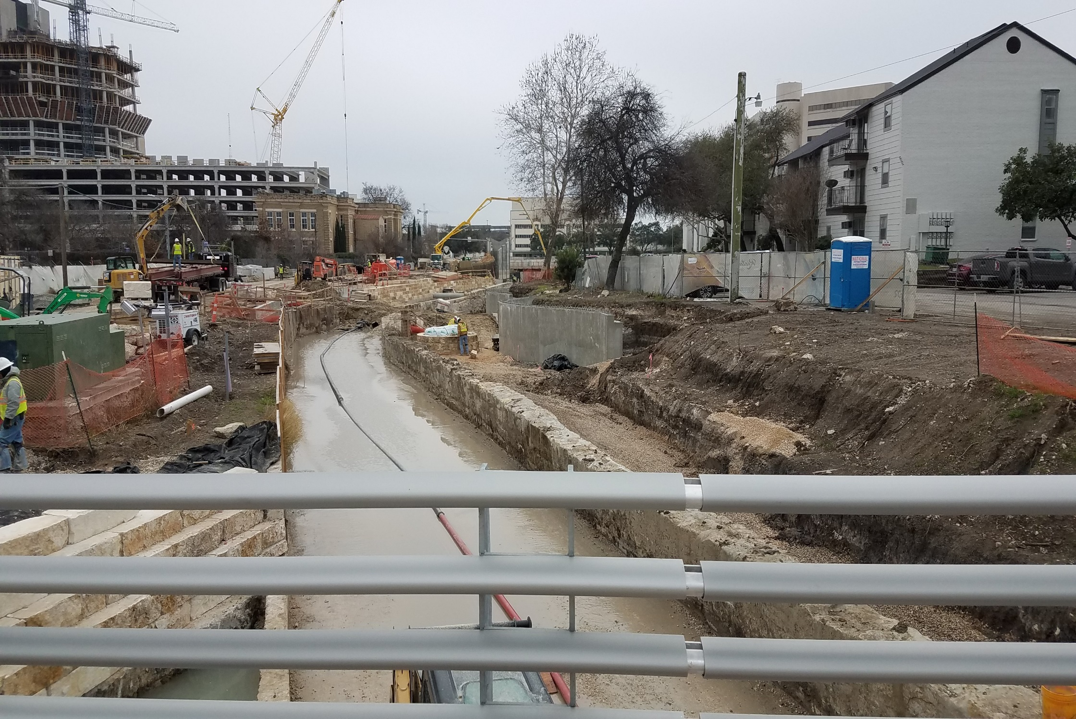

Slide 11
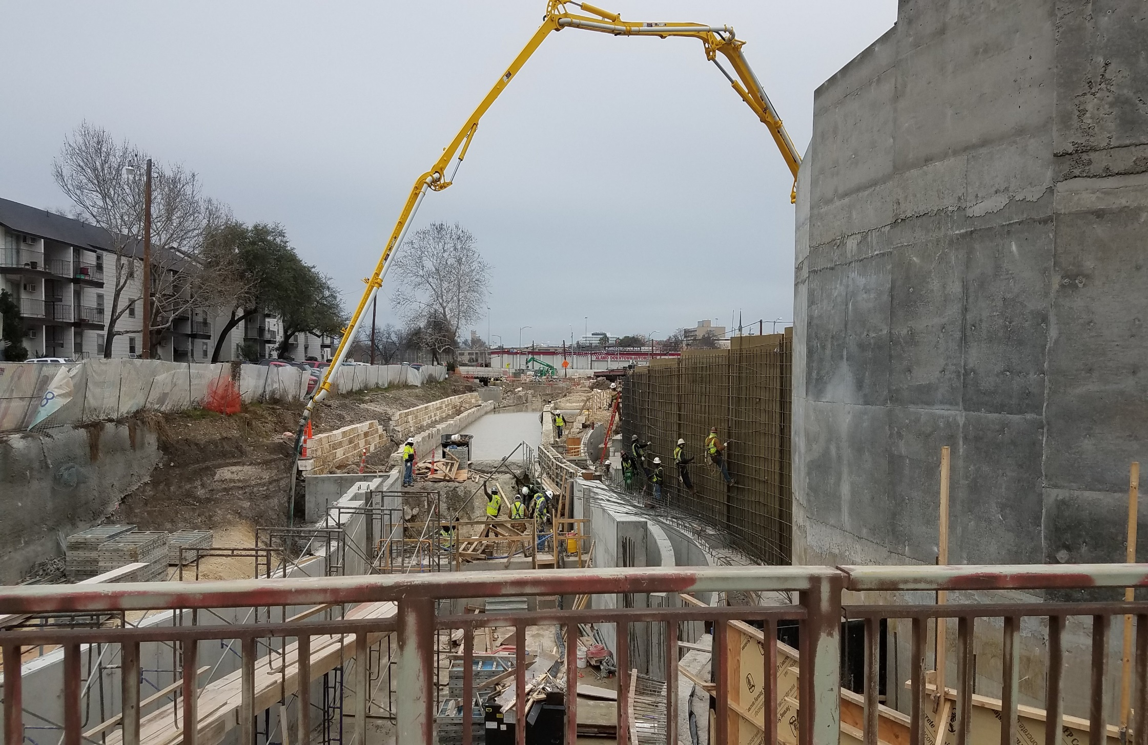

Slide 12
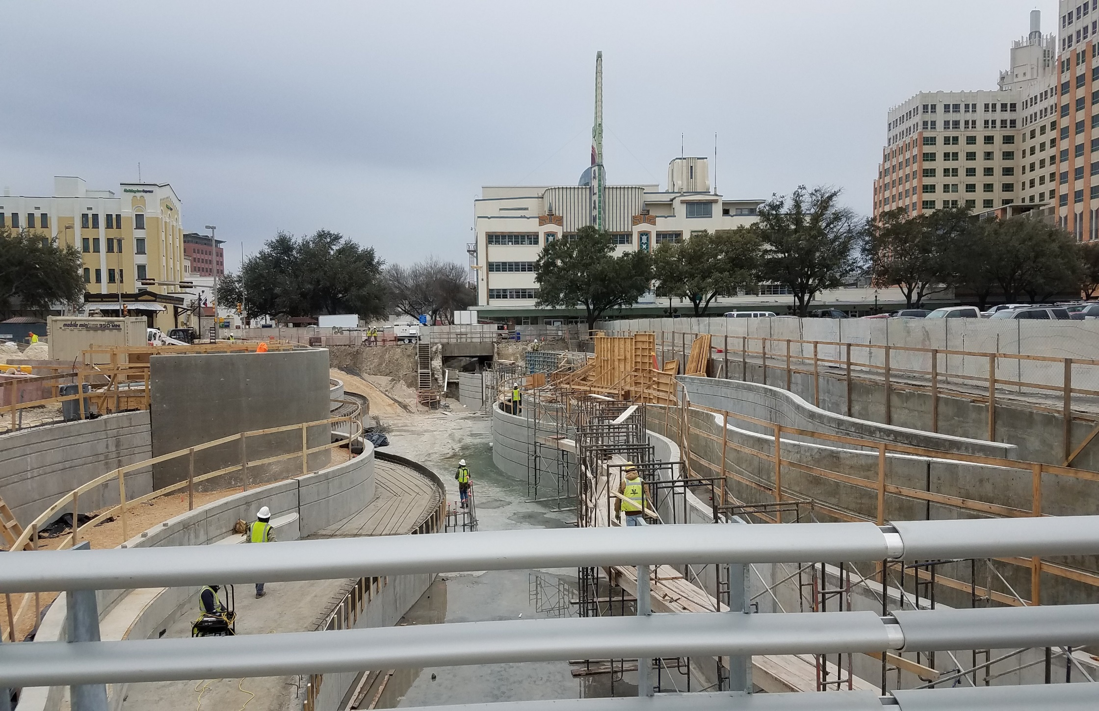

Slide 13
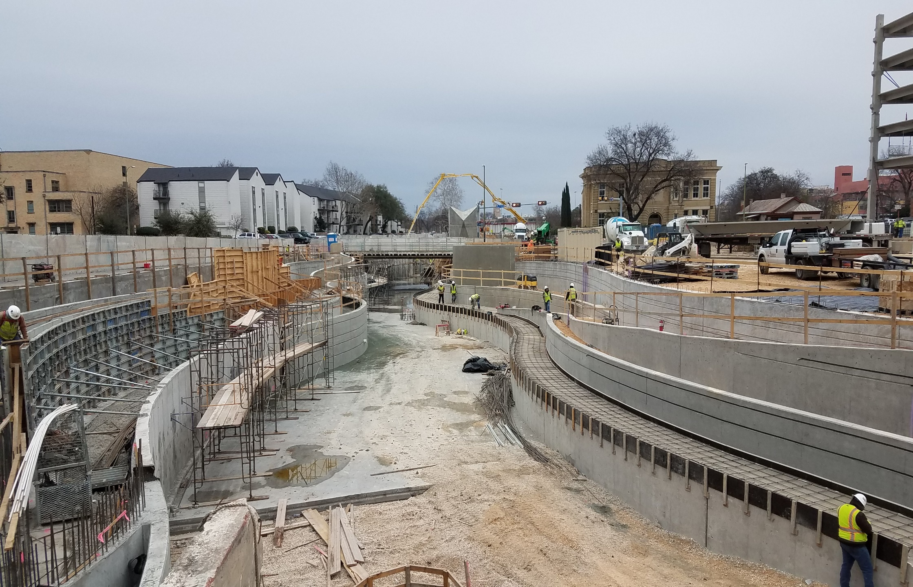

Slide 14
Phase 1.2 Construction Update
Early Work Package 11
Former Dollar General building demolition to begin February 19
Utility relocations ongoing
Early Work Package 12
Demolition and heavy civil work to begin in March
Full construction projected to begin in late summer or early fall

Slide 15
DESIGN ENHANCEMENTS
DESIGN UPDATE

Slide 16
Phase 1.2 Design Update
Design team working towards 90% submittal on February 28
Focus on Houston to Commerce block
Water wall feature
Entertainment plaza
100% design submittal due May 31
Coordination with SDJV ongoing

Slide 17
Phase 1.2 Timeline
100% submittal May 31
90% submittal Feb 28
Guaranteed Maximum Price July 31
Begin Full Construction Late Summer
Begin EWP Construction in February
Construction Completion Mid-2020

Slide 18
Partner Coordination
Commissioners Court
Jan 30: Approval of O&M Agreement between Bexar County, The City of San Antonio, and the San Antonio River Authority
City Council
Feb 8: Approval of Temporary Construction Easements
SARA Board
Jan 17: Approval of budget amendment for Work Packages 11 & 12

Slide 19
Partner Coordination
Executive Committee
David Smith, County Manager, Bexar County
Lori Houston, Assistant City Manager, City of San Antonio
Mike Frisbie, Director, Transportation and Capital Improvements, City of San Antonio
Suzanne Scott, General Manager, San Antonio River Authority
Jan 9: Regular Monthly Meeting

Slide 20
DESIGN ENHANCEMENTS
QUESTIONS
& COMMENTS

Slide 21
SAN PEDRO CREEK ARTS
Program Update

Slide 22
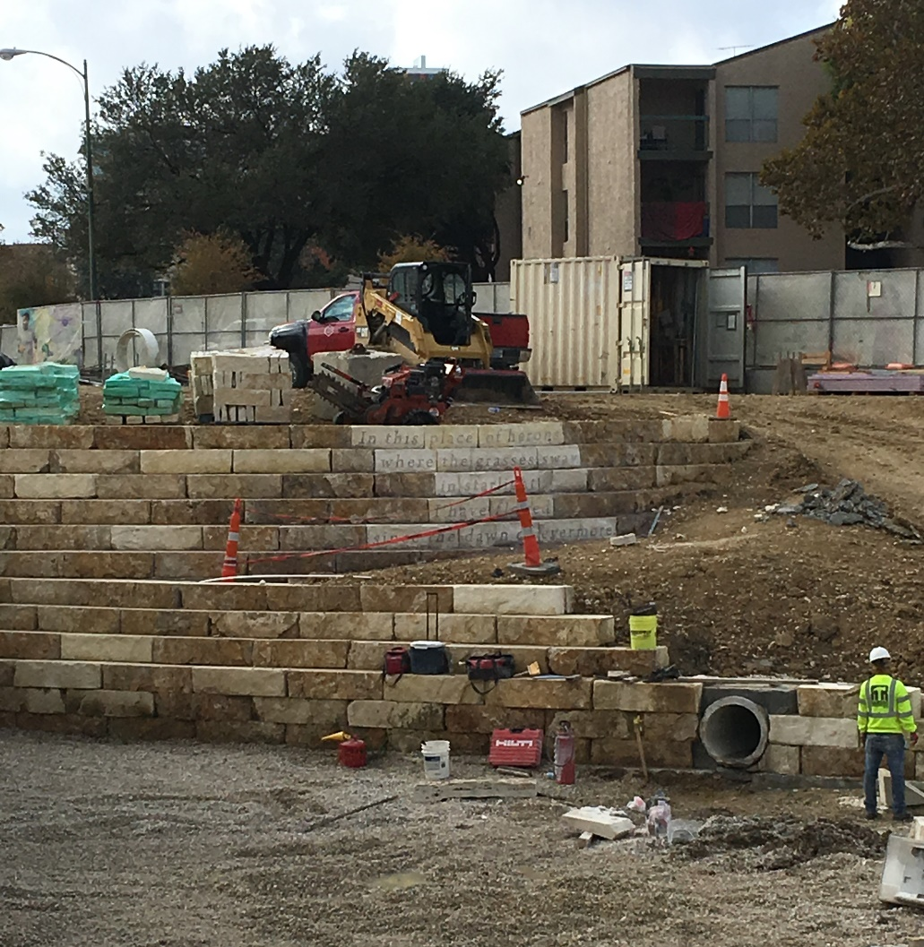
WORD ART
Word Art installed
Investigating paint infill
Notes:
You may recall, I showed this to you last time
On the left are approved mock ups
On the right is a mold for the manantial tile (blue tile)

Slide 23
TILE MURALS
All five murals are in production
Studio visit February 20-21
Installation begins in March
Notes:
And last time you had requested an overview the locations of the Menchaca tiles. I’ve indicated them here in light blue (click 5 times)

Slide 24
PROGRAMMING
Calendar of events
Regular tours (Art and History)
Temporary art installations
Site appropriate events
Arts & Culture Alliance meeting – March 13
Partnerships with local arts organizations
Sponsorship and grant opportunities

Slide 25
DESIGN ENHANCEMENTS
QUESTIONS
& COMMENTS

